Slide 1

COMP821 semester 1 2024
Cloud Computing Security

Slide 2
A Generic Definition of Cloud Computing
Cloud computing is a pay-per-use model for enabling available, convenient, on-demand network access to a shared pool of configurable computing resources (e.g., networks, servers, storage, applications, services) that can be rapidly provisioned and released with minimal management effort or service provider interaction
http://csrc.nist.gov/groups/SNS/cloud-computing/index.html
Notes:
Note 1: Cloud computing is still an evolving paradigm. Its definitions, use cases, underlying technologies, issues, risks, and benefits will be refined in a spirited debate by the public and private sectors. These definitions, attributes, and characteristics will evolve and change over time.
Note 2: The cloud computing industry represents a large ecosystem of many models, vendors, and market niches. This definition attempts to encompass all of the various cloud approaches.

Slide 3
What exactly is Cloud Computing?
When computing services are provided over the Internet
Actual computing is run on a supporting infrastructure which is independent of the applications themselves
The infrastructure can take many forms, but to the end user, the implementation is irrelevant, hence the “cloud” abstraction

Slide 4
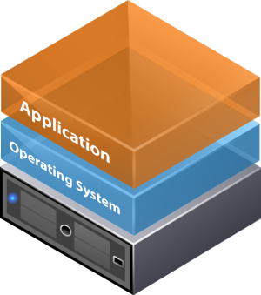
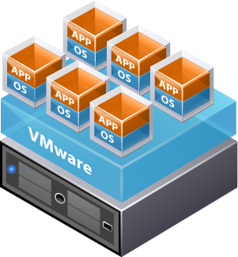
Virtualisation
Non-virtualised
Virtualised
Hypervisor provides the logical separation between VMs. Common hypervisors:
vSphere (VMware)
Hyper-V (Microsoft)
XenServer (Citrix)
KVM (Linux/Redhat)
Virtual Machines (VMs) are logically isolated from each other allowing them to operate as if they were running on standard non-virtualised systems in a multi-tenancy environment

Slide 5
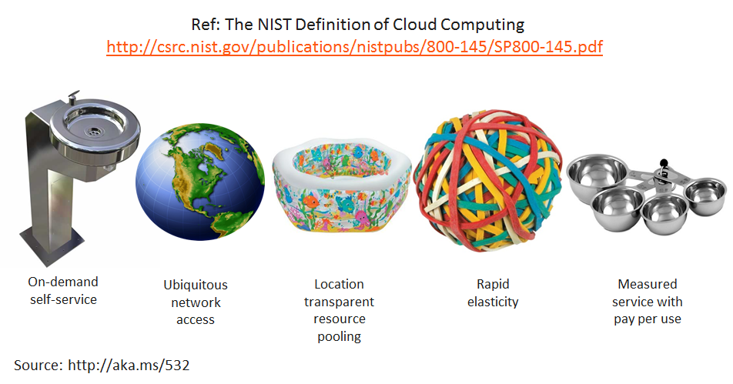
Five Essential Characteristics of Cloud Computing

Slide 6
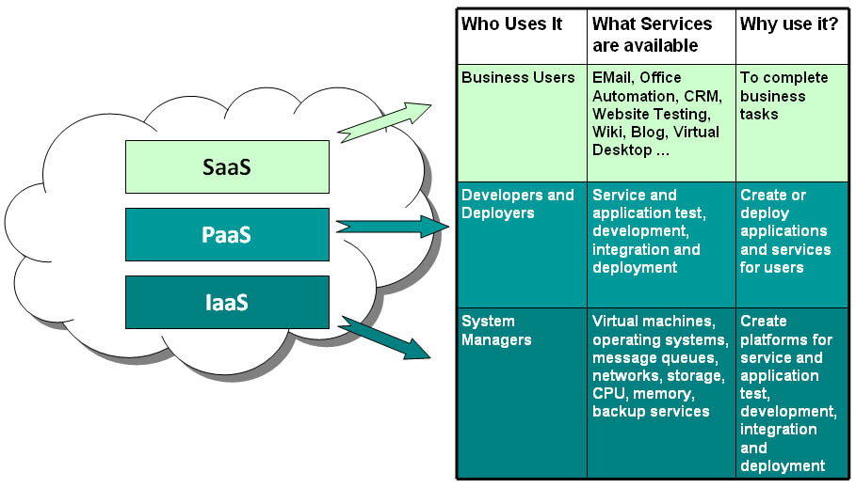
Cloud Computing Service Models: Use-cases
Examples
Gmail
Salesforce
Office365
Microsoft Azure
Google AppEngine
AWS Elastic Beanstalk
AWS EC2
Rackspace
GoGrid
Notes:
Infrastructure as a service, platfporm as a service, software as a service

Slide 7
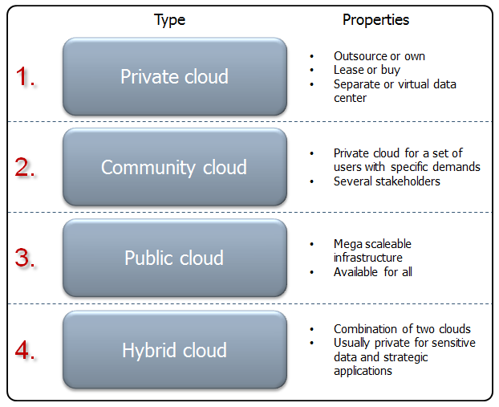
Cloud Computing Deployment Models
Source: http://www.visma.com/blog/cloud-basics-deployment-models/

Slide 8
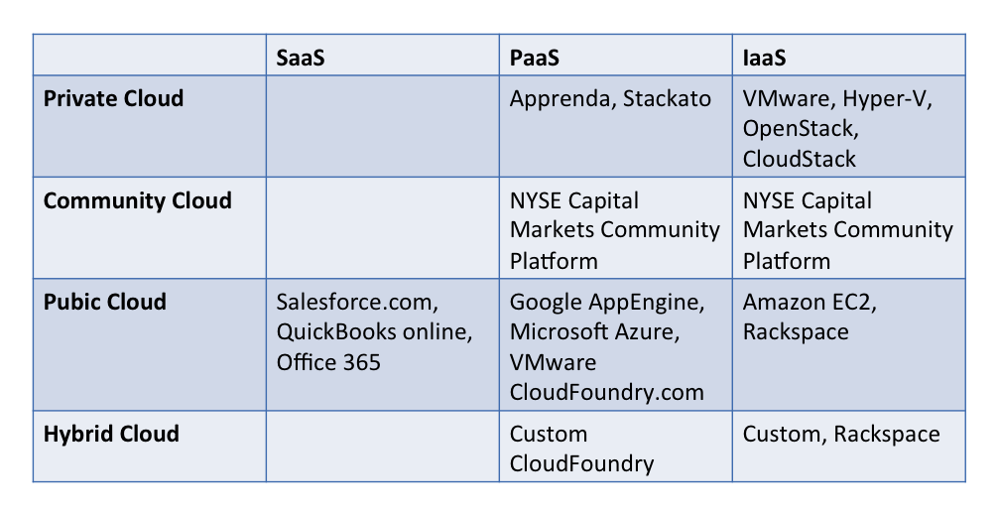
Cloud Computing Models: Service vs Deployment
Source: Derived from NIST Service and Deployment Models

Slide 9
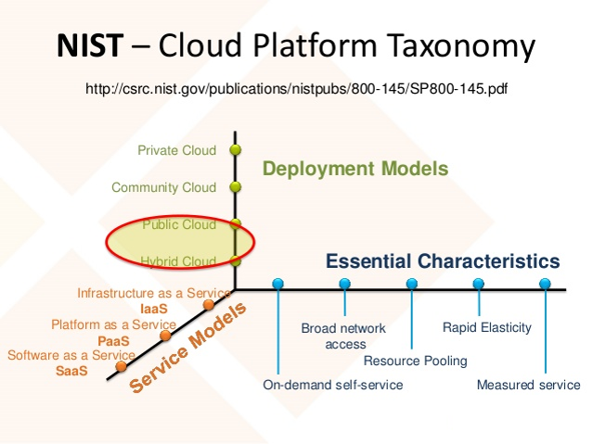
Cloud Platform Taxonomy

Slide 10
Characteristics of Cloud Computing
Dynamically scalable resources often virtualized and offered as services via internet links.
End users do not need to know the exact location, topology and distribution of resources used in the cloud.
Affordability of the services offered due to re-use and the fact that several customers of the CC provider share the resources (multi-tenancy).
CC provider can accommodate diverse user requirements in terms of scalability and availability for a whole range of applications: from commodity services (such as email) to mission-critical applications (i.e. the applications that are at the core of your business/income stream).

Slide 11
Key business advantages of the concept
Key Advantages
Grow your infrastructure as quickly as you do (but not faster!)
Pay for what you use; No up-front investment
Global: be local everywhere, lower latencies, better performance. Quicker response ➔ happier customers.

Slide 12
Infrastructure as a Service (IaaS)
Iaas
Physical layer (servers, switches, storage devices)
Virtualisation layer (virtual machines, hypervisors, etc.)
Unlimited (in practical terms!) on-demand scalability
Great flexibility in terms of operating systems, applications and servers configurations (configuration templates are common).
Example: Amazon Web Services (AWS).

Slide 13
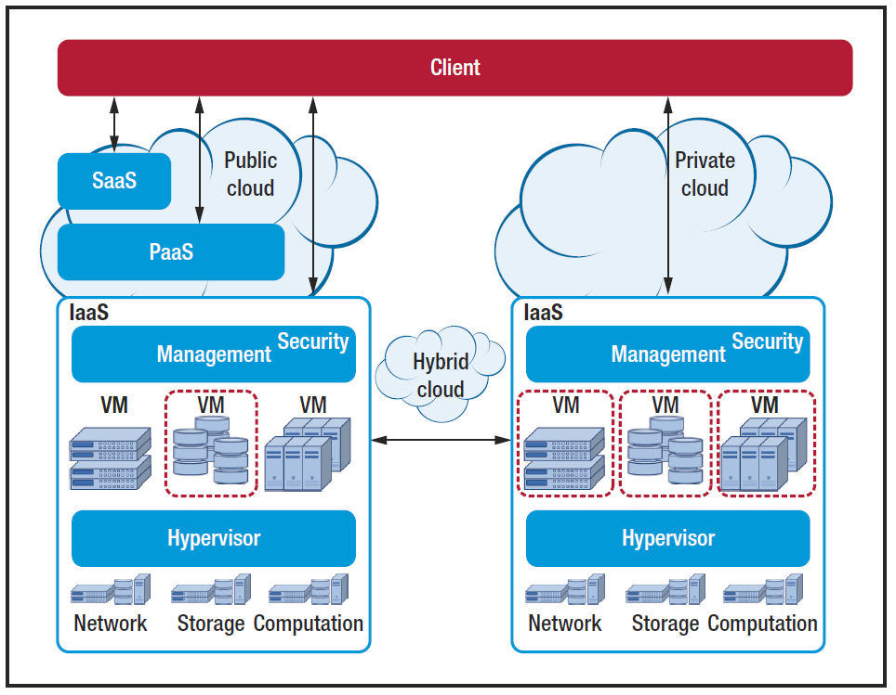

Slide 14
Historical Cloud Computing Security Incidents
Adobe SaaS cloud breach
http://krebsonsecurity.com/2013/10/adobe-breach-impacted-at-least-38-million-users/
Google : was forced to hand over data to govt
http://www.guardian.co.uk/technology/2012/apr/15/web-freedom-threat-google-brin
NSA (National Security Agency) has all of your email
http://www.guardian.co.uk/commentisfree/cifamerica/2012/apr/26/how-national-security-agency-gone-rogue

Slide 15
Cloud Computing Security Incidents - cont
Apple iCloud breach
https://www.neovera.com/icloud-security-breach-learn-anything/
In April 2016, the National Electoral Institute of Mexico was the victim of a breach that saw over 93 million voter registration records compromised due to a poorly configured database.
https://blog.storagecraft.com/7-infamous-cloud-security-breaches/
2021:
Reserve Bank of New Zealand commercial and customer information exposure
https://www.bankinfosecurity.com/reserve-bank-new-zealand-investigates-data-breach-a-15737
Facebook personal data leakage (500m profiles compromised)
https://www.businessinsider.com.au/stolen-data-of-533-million-facebook-users-leaked-online-2021-4?r=US&IR=T

Slide 16
Cloud computing providers must ensure that their infrastructure is secure and that their clients’ data and applications are protected
The Customer must ensure that the provider has taken the proper security measures to protect their information.
Secure Cloud Computing –
a twofold approach

Slide 17
Security Problems with IaaS
Security
Resources are shared: no physical perimeter like in the old days
Insider access
Encryption: who has the keys?
Too many passwords: need for a safe, single sign-on
Does ease of use means low security?
Privacy
Data can be requested by courts
If encrypted courts may request the keys
However, good guidelines exist. See the NIST document (Jensen and Grance, 2011).
Down time (Availability)
Many services unavailable in 2009-2018: Microsoft’s SideKick, PayPal, Amazon, Terremark, Rackspace, gmail, hotmail, Salesforce, Intuit tax service, IBM Datacentre (Auckland).

Slide 18
IaaS security challenges
IaaS is a primary security challenge as the organization is managing a significant proportion of the technology stack
How to scan for security issues on virtual infrastructure when you can’t get physical access?
How to scan for malware and update patches when some VMs are powered off?
How to implement IPS/IDS, firewalls, and DMZ in a virtual network?

Slide 19
IaaS security challenges
How to enforce security policy across a cloud, given mobility?
How can the SLA of the cloud infrastructure be measured?
How can you be assured that your data is being backed up with the granularity that the business requires
See Security Guidance for Critical Areas of Focus in Cloud Computing (pp 79-82) . Available from http://www.cloudsecurityalliance.org/csaguide.pdf

Slide 20
Categorization of threat:
1. Account control
2. Malicious insiders
3. Management console security
4. Data control
5. Multitenancy Issues
Type of attack in cloud provider:
Network-based attacks
Hardware-based attacks
Software-based attacks:
Non-Hypervisor-based attacks.
Hypervisor-based attacks: VMM, Host-based intrusion detection system (HIDS)
Hypervisors: Xen, VMWare, Sphere, KVM
PaaS security challenges

Slide 21
Confidentiality: VM-to-VM attacks, side-channel attacks
Integrity: Data loss, Trust computing platforms
Availability: DoS attacks, Flood attacks
Accountability: Loss of physical control
Privacy: Loss of physical control, Privacy manager
PaaS security challenges - cont

Slide 22
SaaS Identity Challenges
SaaS is great to reduce costs and provide great agility to an organization, but identity is an issue:
Identity is a SaaS/Public Cloud security challenge as data in the cloud is only protected by the employee credentials
How does the customer know the employee logged into a subscribed service such as Salesforce is really an employee?
Do SaaS vendors make security logs available to customer administrators?
Do SaaS vendors provide additional layers of security such as multi-factor authentication?
If an organization subscribes to multiple SaaS services, how do you manage all the user login security?

Slide 23
Data security challenges
Data security challenges are present in all cloud computing models except private cloud.
Organisations are unlikely to know exactly where their cloud data is hosted or which country it is stored in
Data in the cloud can be easily copied in most cases without knowledge of the owner
Organisations are unlikely to be able to identify if data loss or theft is occurring/has occurred
Data stored in other jurisdictions may fall under the legal framework of that jurisdiction
Who owns the data if the cloud vendor business goes bankrupt, and how can a business extract their its data?

Slide 24
Data Sanitisation Challenges
Sanitisation is the process of removing sensitive information from a storage device.
What happens to data stored in a cloud computing environment once it has passed its user’s “use by date”?
What data sanitisation practices does the cloud computing service provider propose to remove redundant and retiring data storage devices as and when these devices are retired or taken out of service?
How are backups sanitized?
What are the implications for cloud computing forensics?

Slide 25
Who is Responsible for CC security?
SaaS
PaaS
IaaS
Private
Data governance & rights management
Client endpoints
Account & access management
Identity & directory infrastructure
Applications
Network controls
Operating system
Hosting infrastructure
Enterprise
Network infrastructure
Other cloud service provider
Physical datacenter

Slide 26
Putting it Together
Most clouds will require very strong security controls, especially government and medical clouds
No current cloud-oriented models for evaluating tradeoff between threat exposure and efficiency
There is no one “cloud”. There are many models and architectures.
How does one choose the most appropriate security architecture? Does one exist?
Notes:
Roman, R., Lopez, J., & Mambo, M. (2018). Mobile edge computing, fog et al.: A survey and analysis of security threats and challenges. Future Generation Computer Systems, 78, 680-698.

Slide 27
Now – are there any CLOUD DISADAVANTAGES
Public cloud vendors have built large data centres across the globe, with enough computing resources to serve a very large number of users.
Cost efficient centralization → significant separation between end user devices and their clouds. →Increase in the network latency and jitter.
→ Cloud services may not able to directly access local contextual information (precise user location, local network conditions, information about users’ mobility behavior).
Notes:
https://arxiv.org/pdf/1602.00484.pdf
Roman, R., Lopez, J., & Mambo, M. (2018). Mobile edge computing, fog et al.: A survey and analysis of security threats and challenges. Future Generation Computer Systems, 78, 680-698.

Slide 28
Computing on the EDGE, and in a FOG
For delay-sensitive applications, such as vehicular networks and augmented reality, low latency and jitter, context awareness, mobility support) are essential .
Novel paradigms: fog computing, mobile edge computing, mobile cloud computing.

Slide 29
EDGE COMPUTING
Notes:
The common denominator in these edge paradigms is the deployment of cloud computing-like capabilities at the edge of the network. Most edge paradigms follow the structure shown in Fig. 1. Edge data centers, which are owned and deployed by infrastructure providers, implement a multi-tenant virtualization infrastructure. Any customer – from third-party service providers to end users and the infrastructure providers themselves – can make use of these data centers’ services. In addition, while edge data centers can act autonomously and cooperate with one another, they are not disconnected from the traditional cloud. It is therefore possible to create a hierarchical multi-tiered architecture, interconnected by a network infrastructure. Besides, we have to consider the potential existence of an underlying infrastructure, or core infrastructure (e.g. mobile core networks, centralized cloud services), that provide various support mechanisms, such as management platforms and user registration services. Finally, one trust domain (i.e. edge infrastructure that is owned by a infrastructure provider) can cooperate with other trust domains, creating an open ecosystem where multitude of customers can be served.

Slide 30
EDGE, FOG, CLOUD: MAJOR EDGE PARADIGMS

Slide 31
EDGE, FOG, CLOUD: MAJOR EDGE PARADIGMS (2)

Slide 32
SECURITY THREATS

Slide 33
Butt, U. A., Amin, R., Mehmood, M., Aldabbas, H., Alharbi, M. T., & Albaqami, N. (2023). Cloud security threats and solutions: A survey. Wireless Personal Communications, 128(1), 387-413. from Section 5 onwards

